Slide 1
Project Planning and Monitoring
Project Conception and Feasibility

Slide 2

What is Project Conception?
Beginning of a Project is the initial step in the
process of defining the actual scope of a project.
Project conception generally starts with an appearance of a requirement or an opportunity that will benefit the corporate interests and ends when one or more preliminary options have been formulated which will, theoretically, satisfy the company’s expectations as originally presented.

Slide 3
Stages of Project Conception
Initial conceptualization of a project has various degrees of complexity, depending on the nature of the specific project and the particular analysis and approval procedures used by an organization.
The organization’s planning strategy may require formulations of programs involving several projects. Conception of the overall program should then precede conception of the individual specific projects.
The conceptual stage involves the following activities:
Definition of a requirement or an opportunity that commands the interests of the company.
Formulation of a set of preliminary alternatives capable of fulfilling the initial
requirement.
Selection of alternative(s) that might satisfy the requirements in terms and conditions attractive to the organization

Slide 4
1. Definition of the Requirement or Opportunity
The continuity of efficient operations and the opening of the new business areas are the main drives for capital investments for industrial firms. Investment opportunities are detected through operational analysis of current performance and by forecasts of the most likely future scenarios.
Initially, the scope of any new investment is likely to be vague. Subsequent definition involves consideration of all available relevant facts, required resource sand constraints associated with the original idea.

Slide 5
2. Preliminary Formulation of the Alternatives
Project conception continues with development of alternatives capable of fulfilling the expressed objectives.
The preliminary formulation of alternatives is important as it sets the pace of the subsequent definition and elaboration of the project scope.
During this phase, the organization calls upon the experience and creativity of its technicians, manager and directors to generate an adequate group of alternatives to fulfill the expressed need.

Slide 6
3. Initial Selection of Alternatives
After the alternatives have been identified, comparative analyses are made in order to select the most beneficial and to reject the least attractive.
The selection process employs a basic feasibility analysis of each alternative the establishment of criteria that will allow the identification of the most attractive options.
At this point, further consideration of the rejected alternative is terminated along with the need to prepare elaborate definitions for them.
The cost, schedule, profitability, and other salient advantages and disadvantages of each of the selected alternatives are assessed in terms of order of magnitude.
Difference among the options is sought still without establishing precise project parameters.

Slide 7
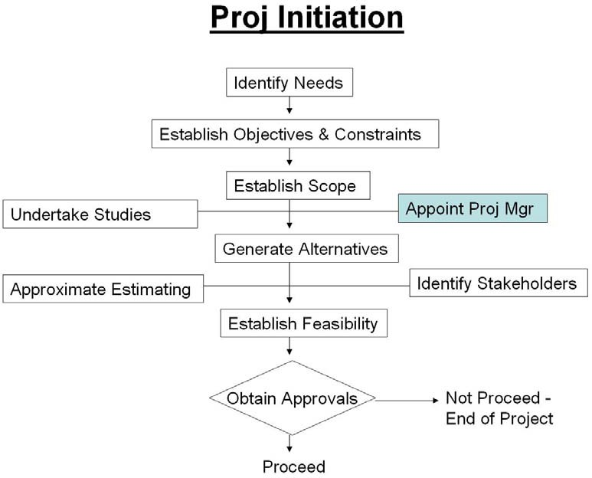

Slide 8
What is a Feasibility Study of a Project?
In a feasibility study, a proposed plan or project is evaluated for its practicality.
As part of a feasibility study, a project or venture is evaluated for its viability in order to determine whether it will be successful.
As the name implies, a feasibility analysis is used to determine the viability of an idea, such as ensuring a project is legally and technically feasible as well as economically justifiable.
It tells us whether a project is worth the investment—in some cases, a project may not be doable.

Slide 9
Understanding A Feasibility Study
A feasibility study is a preliminary exploration of a proposed project or undertaking to determine its merits and viability.
A feasibility study aims to provide an independent assessment that examines all aspects of a proposed project, including technical, economic, financial, legal, and environmental considerations.
This information then helps decision-makers determine whether or not to
proceed with the project.
The feasibility study results can also be used to create a realistic project plan and budget.
Without a feasibility study, it cannot be easy to know whether or not a proposed
project is worth pursuing.

Slide 10
1. Technical Feasibility
This assessment focuses on the technical resources available to the organization. It helps organizations determine whether the technical resources meet capacity
and whether the technical team is capable of converting the ideas into working systems. Technical feasibility also involves the evaluation of the hardware, software, and other technical requirements of the proposed system.
Types of Feasibility Study
2. Financial Feasibility
This assessment typically involves a cost/ benefits
analysis of the project, helping organizations determine the viability, cost, and benefits associated with a project before financial resources are allocated. It also serves as an independent project assessment and enhances project
credibility—helping decision-makers determine the positive financial benefits to the organization that the proposed project will provide.

Slide 11
3. Managerial Feasibility
Demonstrated management capability and availability, employee involvement, and commitment are key elements required to ascertain managerial feasibility. This addresses the management and organizational structure of the project, ensuring that the proponent’s structure is as described in the submittal and is well suited to the type of operation undertaken.
Types of Feasibility Study
4. Economic Feasibility
This involves the feasibility of the proposed project to generate economic benefits. A benefit-cost analysis is required. A breakeven analysis when appropriate is also a required aspect of evaluating the economic feasibility of a project. The tangible and intangible aspects of a project should be translated into economic terms to facilitate a consistent basis for evaluation. Even when a project is non-profit in nature, economic feasibility is critical.

Slide 12
5. Legal Feasibility
This assessment investigates whether any aspect of the proposed project conflicts with legal requirements like zoning laws, data protection acts or social media laws. Let’s say an organization wants to construct a new office building in a specific location. A feasibility study might reveal the organization’s ideal location isn’t zoned for that type of business. That organization has just saved considerable time and effort by learning that their project was not feasible right from the beginning.
Types of Feasibility Study
6. Operational Feasibility
This assessment involves undertaking a study to analyze and determine whether—and how well—the organization’s needs can be met by completing the project. Operational feasibility studies also examine how a project plan satisfies the requirements identified in the requirements analysis phase of system development.

Slide 13
7. Scheduling Feasibility
This assessment is the most important for project success; after all, a project will fail if not completed on time. In scheduling feasibility, an organization estimates how much time the project will take to complete.
Types of Feasibility Study
8. Cultural Feasibility
Cultural feasibility deals with the compatibility of the proposed project with the cultural environment of the project. In labor-intensive projects, planned functions must be integrated with the local cultural practices and beliefs. For example, religious beliefs may influence what an individual is willing to do or not do.

Slide 14
9. Social Feasibility
Social feasibility addresses the influences that a proposed project may have on the social system in the project environment. The ambient social structure may be such that certain categories of workers may be in short supply or nonexistent. The effect of the project on the social status of the project participants must be assessed to ensure compatibility. It should be recognized that workers in certain industries may have certain status symbols within the society.
Types of Feasibility Study
10. Environmental Feasibility
Environmental feasibility is another important aspect that should be considered in project planning. Environmental feasibility refers to an analysis of whether the project is capable of being implemented and operated safely with minimal adverse effects on the environment. Unfortunately, environmental impact assessment is often not adequately addressed in complex projects.

Slide 15
11. Political Feasibility
Political considerations often dictate directions for a proposed project. This is particularly true for large projects with significant visibility that may have significant government inputs and political implications. For example, political necessity may be a source of support for a project regardless of the project's merits. On the other hand, worthy projects may face insurmountable opposition simply because of political factors. Political feasibility analysis requires an evaluation of the compatibility of project goals with the prevailing goals of the political system.
Types of Feasibility Study
12. Market Feasibility
This area should not be confused with the Economic Feasibility. The market needs analysis to view the potential impacts of market demand, competitive activities, etc. and market share available. Possible competitive activities by competitors, whether local, regional, national or international, must also be analyzed for early contingency funding and impacts on operating costs during the start-up, ramp-up, and commercial start-up phases of the project.

Slide 16
Constraints through Feasibility Study
When all areas have been examined, the feasibility analysis helps identify any constraints the proposed project may face, including:
Internal Project Constraints: Technical, Technology, Budget, Resource, etc.
Internal Corporate Constraints: Financial, Marketing, Export, etc.
External Constraints: Logistics, Environment, Laws, and Regulations, etc.

Slide 17
Importance of Feasibility Study
The importance of a feasibility study is based on organizational desire to “get it right” before committing resources, time, or budget. A feasibility study might uncover new ideas that could completely change a project’s scope. Below are some key benefits of conducting a feasibility study:
Improves project teams’ focus
Identifies new opportunities
Provides valuable information for a “go/no-go” decision
Narrows the business alternatives
Identifies a valid reason to undertake the project
Enhances the success rate by evaluating multiple parameters
Aids decision-making on the project
Identifies reasons not to proceed

Slide 18
What is Included in a Feasibility Study Report?
The results of your feasibility studies study are summarized in a feasibility report, which typically comprises the following sections:
Executive summary
Specifications of the item or service
Considerations for the future of technology
The marketplace for goods and services
Approach to marketing
Organization/staffing
Schedule
The financial forecasts
Recommendations based on research

Slide 19
Purpose of a Feasibility Study
A feasibility study is an important first step in starting a new business. It is a detailed examination of whether or not a proposed business venture is likely to be successful. A feasibility study aims to provide information that will help business owners make informed decisions about their new venture. The feasibility study will answer important questions about the proposed business, including:
What is the target market for this business?
Who are the competitors?
What are the costs associated with starting and running this business?
What are the potential risks and rewards associated with this venture?
How much revenue can this business generate?
What are the estimated profits and losses for this business?
What is the potential for growth in this industry?

Slide 20
7 Steps to Do a Feasibility Study

Slide 21
1. Conduct a Preliminary Analysis
A preliminary investigation is necessary to determine whether a full feasibility study is warranted. During this stage, key information will be gathered to assess the project's potential and make a preliminary decision about its feasibility. This should include a review of relevant documents, interviews with key personnel, and surveys of potential customers or users.

Slide 22
2. Prepare a Projected Income Statement
To do a feasibility study, one must create a projected income statement. The projected income statement will show how much money a business is expected to make in the coming year. It will include both an estimated revenue and an estimated expenses. This document will be essential in helping one make informed decisions about his/her business.

Slide 23
3. Conduct a Market Survey, or Perform Market Research
Conducting market research is an important step in any feasibility study. By understanding the needs and wants of potential customers, one can determine if there is a market for his/her product or service. One can also get an idea of what his/her competition is doing and how to best position the business to meet the needs of his/her target market.
There are a variety of ways to conduct market research. One popular method is to conduct a survey. One can survey potential customers directly or use data from secondary sources such as surveys conducted by other organizations. One can also use focus groups or interviews to get feedback from potential customers.
Once the data is gathered, one can use it to create a profile of his/her ideal customer. This will help to understand the target market and how to reach them.

Slide 24
4. Plan Business Organization and Operations
When starting a business, one of the first things one need is to plan his/her organization and operations. This involves creating a structure for his/her company and figuring out the logistics of how he/she will run it. There are many factors to consider when planning organization and operations, such as:
Company Structure: What type of company will it be (sole proprietorship, partnership, corporation, etc.)? How will the hierarchy look like?
Location: Where will the business be located? Will it have a physical storefront or will operate online only?
Marketing: How will the business be promoted ?

Slide 25
5. Prepare an Opening Day Balance Sheet
The opening day balance sheet is a snapshot of the company's financial position at the beginning of the business venture. The purpose of the opening day balance sheet is to give an idea of the amount of money that the company has to work with and track its expenses and income as they occur. This information is vital to making sound business decisions. The opening day balance sheet will include the following:
Cash on hand
Accounts receivable
Inventory
Prepaid expenses
Fixed assets
Accounts payable
Notes payable
Long-term liabilities
Share

Slide 26
6. Review and Analyze All Data
The feasibility study should include reviewing and analyzing all data relevant to the proposed project. The data collected should be verified against source documentation, and any discrepancies should be noted. The purpose of the feasibility study is to provide a basis for making a decision, and the data should be sufficient to support that decision.
The analysis should consider both the positive and negative aspects of the proposed project. The financial analysis should be thorough, and all assumptions should be documented. The risk assessment should identify any potential risks and mitigation strategies. The team assigned to the project should review the feasibility study and recommend the organization's leadership.
Organizational leadership should decide whether to proceed with the project based on the feasibility study's findings. If the project is approved, the organization should develop a project plan that includes a detailed budget and timeline

Slide 27
7. Make a Go/No-Go Decision
It is important to know when to cut losses when starting a business. The go/no-go decision in a feasibility study comes in. The go/no-go decision is a key part of a feasibility study, and it can help one determine whether or not his/her business idea is worth pursuing.
Making the go/no-go decision is all about risk assessment. One need to weigh the risks and rewards of starting his/her business and decide whether the potential rewards are worth the risks. If the risks are too high, one may want to reconsider his/her business idea.

Slide 28
Thanks

